Slide 1

From Scratch to Smart
A 3-Phase Demo: Pre-training, SFT, and RLHF

Slide 2
The "Baby" Model: Our Starting Point
We start with a `ToyLLM`. Its 'brain' (weights) is completely random. When we ask it a question, its answer is meaningless garbage.
"
"
Prompt: 'alice followed'
Response: 'alice rabbit queen cat curious...'

Slide 3




The Core NLP Building Blocks
Tokenization
Embeddings
A "vocabulary" to turn words like 'alice' into simple numbers like [12].
A "dictionary" that maps these numbers to *meaning vectors* that the model can learn.

Slide 4

Phase 1: Foundational Pre-training
Goal: Learn Language Structure
We teach the model the basics of language by making it predict the next word over and over.
•
Method: Next-Word Prediction
•
Data: Simple sentences from "Alice in Wonderland."
•
Example: Show it "alice followed the..." and teach it to predict "...white".

Slide 5
Pre-training Result: A "Completer"
The model is no longer random! It completes sentences based on the 'Alice' facts it learned. But it can't *answer* questions.
"
"
Prompt: 'who did alice...'
Response: 'who did alice follow the...'

Slide 6
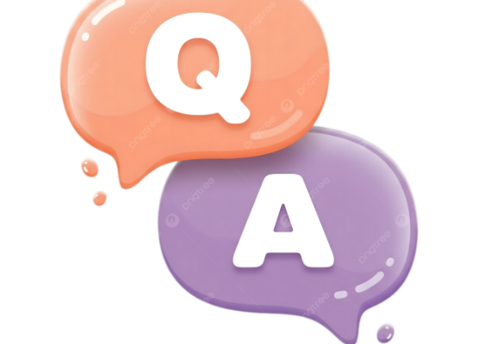
Phase 2: Supervised Fine-Tuning (SFT)
Goal: Teach Factual Answers
We teach the model to be a helpful "expert" by showing it "flashcards" of (Question, Answer) pairs.
•
Method: Instruction Following
•
Data: Q&A pairs.
•
Example:
Prompt: 'who did alice follow'
Answer: 'alice followed the white rabbit'

Slide 7
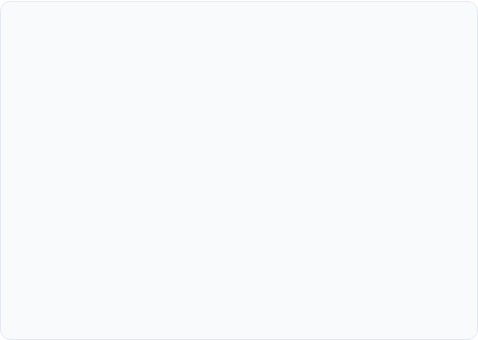

SFT Result: A "By-the-Book" Expert
Good: Trained Questions
Bad: New Questions
It perfectly answers the *specific questions* it was trained on.
When asked a *new* question, it falls back on its pre-trained "completer" knowledge.
Prompt: 'what did the cat do'
Prompt: 'who was alice'
Response: 'the cheshire cat smiled'
Response: 'alice was very curious'

Slide 8
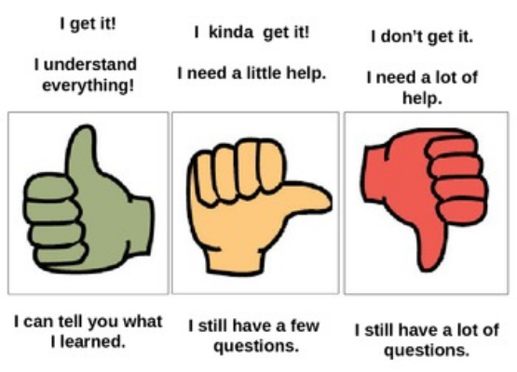
Phase 3: Reinforcement Learning (RLHF)
Goal: Teach Preferences
We teach the model what a "good" answer *feels* like, even for new questions.
1.
Model generates an answer.
2.
A "Reward Model" (Judge) scores it.
3.
We update the model to get more "points" from the judge in the future.

Slide 9
RLHF Result: An "Aligned" Model
The model is now "steered" by our preferences. Our judge "rewarded" the answer 'alice was very curious', teaching the model that this is a good, helpful response.
"
"
Prompt: 'who was alice'
Response: 'alice was very curious'

Slide 10



The Model's Evolution: A Comparison
Pre-Trained
SFT
RLHF
Prompt: 'who did alice follow'
Response: 'who did alice follow the...'
Prompt: 'who was alice'
Response: 'who was alice said the...'
Prompt: 'who did alice follow'
Response: 'alice followed the white rabbit'
Prompt: 'who was alice'
Response: 'alice was very curious'
Prompt: 'who did alice follow'
Response: 'alice followed the white rabbit'
Prompt: 'who was alice'
Response: 'alice was very curious'

Slide 11
Key Demo Takeaways
Pre-training teaches *language* and *facts*. It creates a "completer."
SFT teaches *instruction following*. It creates an "expert."
RLHF teaches *preferences*. It creates an "aligned" assistant.

Slide 12
Questions?

Slide 13
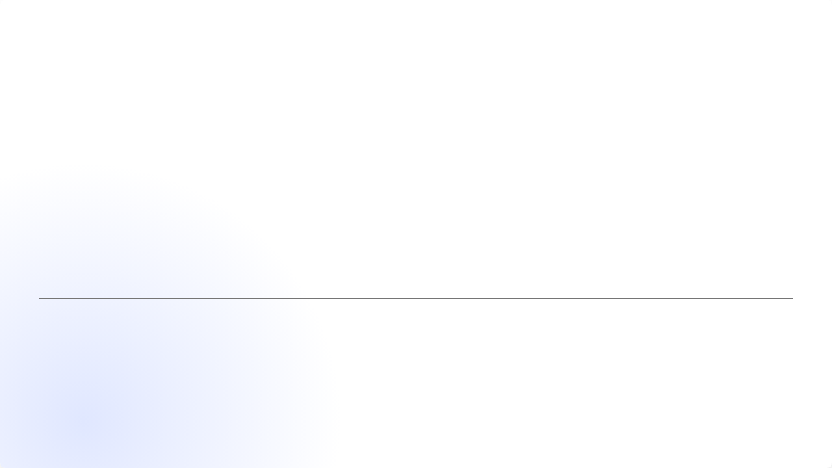





Image Sources
https://media.istockphoto.com/id/1412637153/photo/magic-book-with-open-pages-and-abstract-lights-shining-in-darkness-literature-and-fairytale.jpg?s=612x612&w=0&k=20&c=rc3Bh74ePX8QPGnOi5oeEYOwFaJYsseXu8A0dGFqRzI=
Source: www.istockphoto.com
https://png.pngtree.com/png-clipart/20250422/original/pngtree-stylized-q-a-speech-bubbles-illustration-png-image_20849901.png
Source: pngtree.com
https://ecdn.teacherspayteachers.com/thumbitem/Thumbs-Check-for-Understanding-1609884359/original-268414-1.jpg
Source: www.teacherspayteachers.com

